Slide 1
Introduction to Causal Inference
Prof. Sebastián Vallejo Vera

Slide 2
Why causality?
Most of the questions of interest for us (i.e., social scientists) are causal.
There are some questions that are not causal and are interesting nonetheless (e.g., normative questions).
Social scientists strive to establish causal relationships, that is, evaluate how changes in a variable of interest (X) affects the values in another variable (Y).

Slide 3
Education
Income
Partisanship
Vote Choice
Small Loans
Poverty
X
Y

Slide 4
We are not interested in a mere statistical association between two variable through a correlation analysis.
We want to show—within previously agreed margins of uncertainty—that changes in one variable cause change in another.
And then use our comparative advantage as social scientist to tell convincing stories about society and power.

Slide 5
What is causal inference?

Slide 6
What is causal inference?
The ”causal” component refers to establishing cause-to-effect relationships of the type X→Y (where X is the cause—independent/explanatory variable—and Y the effect—dependent/outcome variable);

Slide 7
What is causal inference?
The ”causal” component refers to establishing cause-to-effect relationships of the type X→Y (where X is the cause—independent/explanatory variable—and Y the effect—dependent/outcome variable);
The ”inference” component refers to forming judgments about the reliability of statistical relationships in a population on the basis of random sampling.

Slide 8
What is causal inference?
Thus, causal inference refers to the process of drawing a conclusion about the response of the effect variable (Y) when the values of the causal variable (X) is changed in a population on the basis of a random sample from that population.

Slide 9
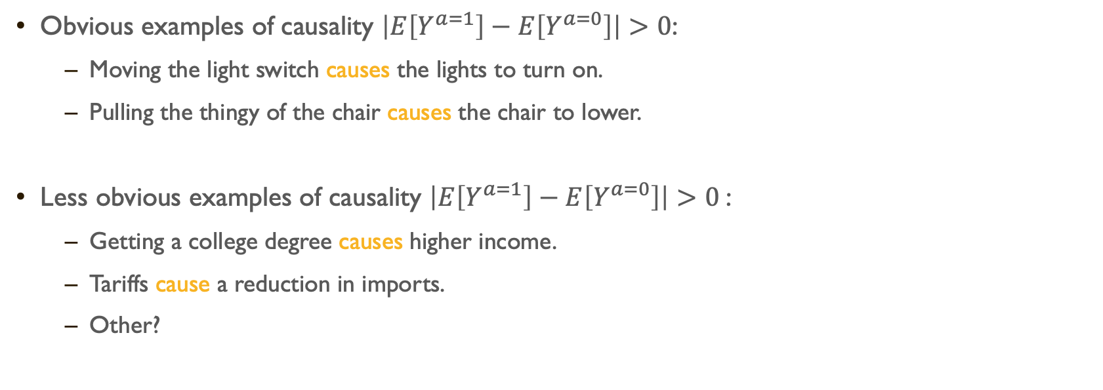
Examples of Causality
Obvious examples of causality $\left|E\left[Y^{a=1}\right]−E\left[Y^{a=0}\right]\right|>0$:
Moving the light switch causes the lights to turn on.
Pulling the thingy of the chair causes the chair to lower.
Less obvious examples of causality $\left|E\left[Y^{a=1}\right]−E\left[Y^{a=0}\right]\right|>0$:
Getting a college degree causes higher income.
Tariffs cause a reduction in imports.
Other?

Slide 10
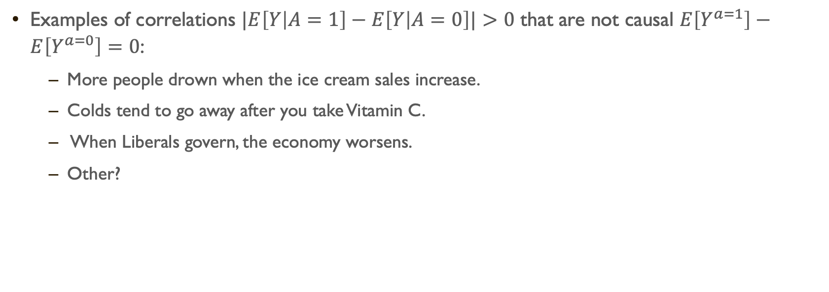
Examples of correlations
Examples of correlations $|E\left[Y | A=1\right]−E\left[Y | A=0\right]|>0$ that are not causal $E\left[Y^{a=1}\right]−E\left[Y^{a=0}\right]=0$:
More people drown when the ice cream sales increase.
Colds tend to go away after you take Vitamin C.
When Liberals govern, the economy worsens.
Other?

Slide 11
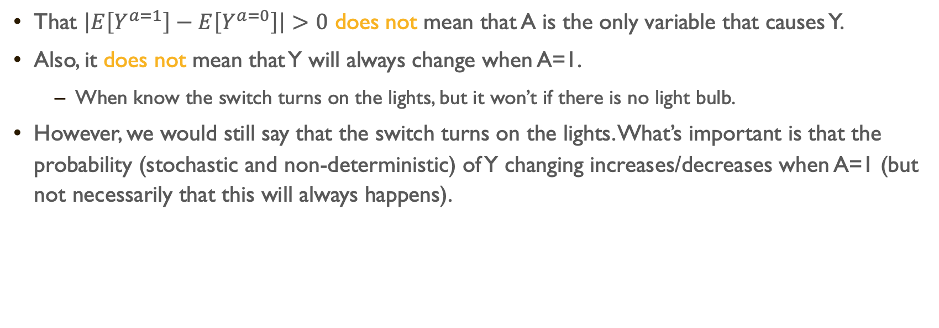
Important Note:
That $\left|E\left[Y^{a=1}\right]−E\left[Y^{a=0}\right]\right|>0$ does not mean that A is the only variable that causes Y.
Also, it does not mean that Y will always change when A=1.
When know the switch turns on the lights, but it won’t if there is no light bulb.
However, we would still say that the switch turns on the lights. What’s important is that the probability (stochastic and non-deterministic) of Y changing increases/decreases when A=1 (but not necessarily that this will always happens).

Slide 12
The path to causality is a difficult one
(as are the paths of love)

Slide 13
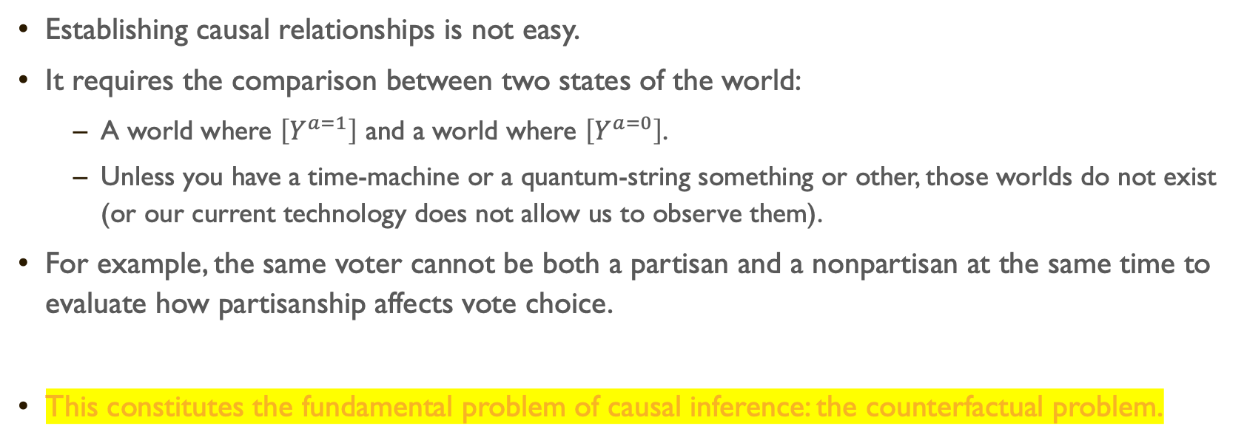
Establishing causal relationships is not easy.
It requires the comparison between two states of the world:
A world where $\left[Y^{a=1}\right]$ and a world where $\left[Y^{a=0}\right]$.
Unless you have a time-machine or a quantum-string something or other, those worlds do not exist (or our current technology does not allow us to observe them).
For example, the same voter cannot be both a partisan and a nonpartisan at the same time to evaluate how partisanship affects vote choice.
This constitutes the fundamental problem of causal inference: the counterfactual problem.

Slide 14


Slide 15
Estimating causal Effects

Slide 16
Randomized trails
Among the numerous research designs at hand, the one that circumvents best the fundamental problem of causal inference is the randomized experiment, also called randomized trial.
In a randomized trial, the researcher randomly assigns specific values of the causal variable to groups of people. Generally, members of one group receive an experimental manipulation like a small loan—labeled treatment group—and members of the other group do not receive it (no loan)—control group.
Random assignment of the experimental manipulation makes other things equal hold on average across the groups.

Slide 17
Randomized trails
Ok, but why does this work?
One way to think about this is in the same way that we think about sampling:
The distribution of the means of infinite samples from a population will have a normal distribution (i.e., central limit theorem). With a big enough N, samples are increasingly more likely to be similar.
Now, take two of these random samples. If the risk of receiving the treatment is the same for both sample (i.e., if it does not matter which groups receives the treatment; if being treated is independent from the outcome), then the only difference between these two groups is the treatment itself. It’s as if these groups were… exchangeable.

Slide 18
Randomized trails
Let’s see this in action (go to code for 3 Intro to Causal Inference.R / Vignette 2.1)

Slide 19
Observational data
The problem is that experimental data are not always readily available, and some social phenomena simply cannot be studied through randomized trials.
We cannot randomly assign democracy to a country to estimate its effect on development.
Frequently, researchers must rely on nonexperimental data, also called observational data or retrospective data.
When working with observational data, researchers have a hard time holding other relevant things equal. In other words, finding a perfect counterfactual to a specific state of the world (to which we could compare to estimate the causal effect of interest).
Why is Canada under a Liberal Government in 1995 a bad counterfactual to Canada under a Conservative Government in 1985?

Slide 20
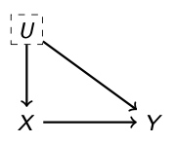
Observational data
When estimating causal effects using observational data, researchers face one important problem: omitted variables bias.
A situation where one or many variables that affect both the dependent and the independent variable of interest are left uncontrolled (e.g., leaving motivation out when explaining how education affects income).

Slide 21
Let’s see this in action (go to code for 3 Intro to Causal Inference.R / Vignette 2.2)

Slide 22
Observational data
Unlike our simulated example, we can never be sure that such relevant variable(s) have been left out and their omission might cause us to mistakenly draw (biased) inferences.
These unmeasured and/or unaccounted attributes are also called confounders or lurking variables or unobserved heterogeneity.

Slide 23
Observational data
In randomized trials, random assignment implies that the observed and unobserved factors that affect the dependent/outcome variable are equally likely to be present in the control and treatment groups.
Luckily, social scientists (mainly econometricians) have developed statistical tools to isolate (as best as possible) causal effects using observational data.
In this course, we will explore the three following tools (time permitting):
Regression analysis
Regression discontinuity design (RDD) (like in the code!)
Difference-in-Differences (DiD)
There are other techniques like instrumental variables and matching (which you can explore on your own in most textbooks in the Syllabus).

Slide 24
The Structure of the Data
Observational data come under different structures and each data structure requires specific treatment to evaluate causal relationships.
In this course, we focus mostly on one data structure: cross-sectional data. Cross-sectional data consist of a sample of individuals, households, cities, states/provinces, countries, or any variety of other units, taken at a given point in time (Prof. Lebo will show you how things that vary in time can cause inference problems).

Slide 25
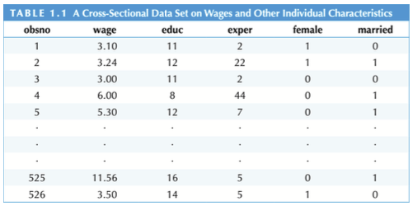

Slide 26
Lab Exercises
From ’wooldridge’:
C5. The data ’fertil2’ were collected on women living in the Republic of Botswana in 1988. The variable children refers to the number of living children. The variable electric is a binary indicator equal to one if the woman’s home has electricity, and zero if not.
(i) Find the smallest and largest values of children in the sample. What is the average of children?
(ii) What percentage of women have electricity in the home?
(iii) Compute the average of children for those without electricity and do the same for those with electricity. Comment on what you find.
(iv) From part (iii), can you infer that having electricity “causes” women to have fewer children? Explain.

